Slide 1
Essay writing is a process
Understand the topic – define keywords
Research - brainstorm, mind map, read
Take notes – use your own words unless quoting, note referencing details
Plan – organise your ideas
First draft – get down main ideas
Re-draft – focus on structure
Edit – polish, check spelling and wordcount
Notes:
Make an active choice of the topic for positive reasons.
This session will focus on understanding the topic, planning, structuring and drafting.

Slide 2
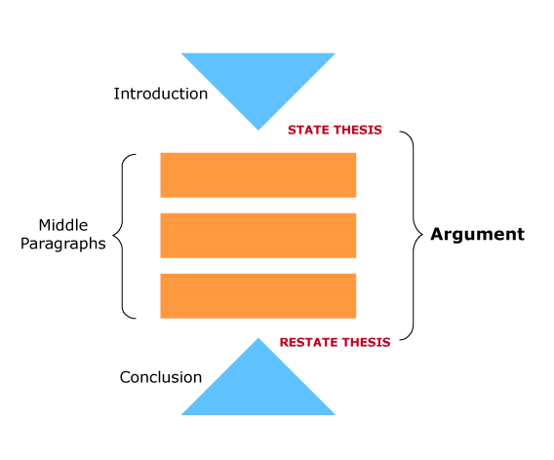
PLAN – academic structure
Approximately 10% of total word count
Approximately 10% of total word count
Notes:
A thesis statement is a single sentence or two which briefly states what the paper is about and what argument will be advanced.

Slide 3
Hypothetical plan – do your maths 2000 words?
Introduction 200 w.
Body: 1600 w.
  Paragraph 1 – approx. 250 words
  Paragraph 2 – approx. 250 words
  Paragraph 3 - approx. 250 words
  Paragraph 4 –approx. 250 words
  Paragraph 5 –approx. 250 words
  Paragraph 6 – approx. 250 words
Conclusion 200 w.
References
Notes:
First step of a plan – what will be in each paragraph (big picture)
Body paragraphs could be just over 300 words each but depends on weighting of marks
Point here is to divide the essay up before you start so that different chunks can be written separately.
NOTE: this is a hypothetical plan which will not work for these two essays under review in this workshop.

Slide 4
Possible SWB Plan : paragraphs
Introduction 200 words
Section 1 - competing theoretical explanations 800 words
  Para 1 Theory 1 (Individual explanations)
  Para 2 Theory 2 (MD/mainstream/conventional explanations)
  Para 3 Theory 3 (Critical/Structural explanations)
Section 2 - a preferred way of understanding inequality and poverty 800 words
  Para 1 Your argument for a preferred way of understanding
  Para 2 Your argument for a preferred way of understanding
  Para 3 Linking your argument to SW Values
Conclusion 200 words
Notes:
A POSSIBLE plan.
Note that these sections are too large for separate paragraphs. Each section would need to be divided into 2 or 3 paragraphs.

Slide 5

Write: The introduction
Set the topic; what is this all about?
use key terms (define here or in first paragraph)
Narrow the focus; what is this essay about?
Thesis statement; clearly express your point of view
Signpost how the essay will unfold
- may be easier to write after the body!

Slide 6
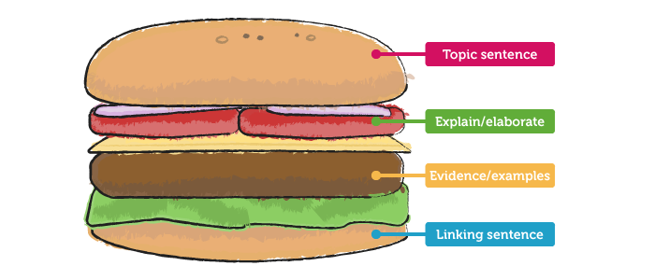
Write: Body paragraphs
Series of linked paragraphs
One idea per paragraph
Topic sentence, explanation and evidence in each paragraph
Each piece of evidence is referenced
T
E
E
L

Slide 7
Paragraph example
Topic sentence
Explanation
An alternative practice theory to task focused practice, is strength-based practice. Strength based practice is . . . (ref). It acknowledges that a client has . . . (ref). A key feature of this practice is asking questions about . . . (ref). This is usually completed using the . . . (ref). Strength based practice is universal and has a number of key strengths which include . . . (ref). However, there are two significant limitations associated with this strength based practice and these limitations could impact the way in which I work with my client. Firstly, Smith (2015) has argued that the practice is too simplistic. This could impact my work . . . Another limitation is that . . .(ref). Again, this would be important for my work because . . . It would appear, then, that this practice would not be the best way to work therapeutically with Bill. A systems approach could be much more beneficial.
E
v
i
d
e
n
c
e
Link
Notes:
Note the other linking words which join pieces of evidence together – eg. however, firstly, another

Slide 8
Examples of topic sentences:
Peter’s experience of marginalisation and structural oppression is further compounded by his aboriginality.
Jo would benefit from referral to several community services.
There are a number of roles a social worker can adopt for the process of intervention.
Fear of reprisals was experienced as a distinct barrier to disclosing child sexual abuse for these participants.
Notes:
Ask students to anticipate what the rest of the paragraph will be about.

Slide 9

Write : The Conclusion
Echo the introduction – restate thesis
Summarise main points
(no new points, no references)
Any implications? From this it can be seen…
Leaves a final impression – so what?

Slide 10
Mind your language
Avoid colloquialisms, informal language (kids)
Do not use contractions (isn’t, won’t)
Do not use abbreviations (uni, prac, etc)
Use tentative language (could, may, should, possibly . . .)
Use a variety of reporting verbs (refutes, claims, suggests . . .)
Be impersonal/ objective (no I, me, my, we, us, our, you, your)
  Note: however, often your essays require you to be reflective
Notes:
IPP is a reflective essay so you will use I when discussing your own values.
Use third person when referring to literature. Eg. The social worker should be aware of their individual values which may impact on professional work (Smith, 2015).

Slide 11

https://www.latrobe.edu.au/students/study-resources/learninghub
Notes:
All appointments are online now until further notice. This is the Learning Hub webpage.
Learning Hub staff, PLAs and Library staff are available.

Slide 12

Learning Hub LMS page – available to all students
Best tiles for academic skills
Notes:
This is what the rest of the Learning Hub page looks like

Slide 13

Studiosity (access 24/7)
Notes:
Studiosity can be used in 2 ways:
Once a student registers, they can have a 1:1 online chat with an academic skills advisor who can assist them with any issues
Students can submit a piece of work for comment before it is finally submitted for assessment. Feedback by Studiosity is given and students can then opt to include this feedback in their final submission. Allow about 24 hours at least.
This is a free and confidential service.
Studiosity is free and confidential. Students can use it up to 5 times/semester.

Slide 14

Any questions?

